Slide 1
Python Introduction

Slide 2
Python:
Python is,
Interpreted
High level
OOP, language(Object Oriented Programming)
Uses:
Dynamically typed language ( ex: a=10).
Platform independent (Windows, Mac, Linux, Raspberry Pi, etc).
Simple syntax, fewer lines of code compared with other languages.

Slide 3
Features:
Popular programming language.
General purpose programming language.
High level language.
Python is an interpreted language. No need to compile.
Open source and free.
It is an Object Oriented Programming language.
It is very easy to learn.

Slide 4
Applications:
Web application
Desktop GUI application
Console based application
Software development
Scientific & numeric
Artificial intelligence
Audio or Video based application
3D CAD application
Enterprise application
Image processing application
Data science
Mobile application
Machine learning, Gaming, Testing, Education, Networking, DevOps etc.

Slide 5
History:
It was developed by Guido Van Rossum from CWI (Centrum Wiskunde & Informatica).
It is released in 1991.
He named Python from his favourite Tv Show “Monty Python’s Flying Circus” .
It support both procedural and OOP approaches.

Slide 6
Interactive mode:
In interactive mode, the python code can be directly typed and the interpreter displays the results immediately.
Ex 1:
>>> 5 + 10
15
>>> 5 + 50 * 10
505
>>> 5 ** 2
25
Ex 2:
>>> print(“Python Programming Language”)
>>> x = 10
>>> y = 20
>>> z = x + y
>>> print(“The sum = ”, z)
The sum = 30

Slide 7
Script mode:
It is reusable code.
Once the script is created, it can be executed again and again without retyping.
The scripts are editable.
Ex:
a = 100
b = 200
c = a + b
print(“The sum = ”, c)

Slide 8
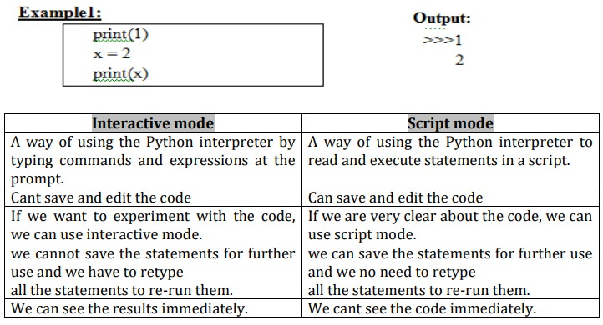
Difference between Interactive and script mode:

Slide 9
IDLE DEVELOPMENT ENVIRONMENT:
IDLE is an Integrated Development Environment for python, typically used on windows.
Multi-window text editor with syntax highlighting, auto-completion, smart indent and other.
Python shell with syntax highlighting.

Slide 10
IDLE-TYPES:
Python can be edited using many editors. Some of the examples are
Pycharm
Atom
Thonny
IDLE
Example program for python:
Print(“Hello World”)
Output:
Hello World

Slide 11
VARIABLES
These are most common fact in all the programming languages.
We use variables to temporarily store data in computers memory.
Based on the data type of a variable, the interpreter allocate memory and decides what can be stored in the reserved memory.
This means when you create a variable, you reserve some space in memory.

Slide 12
VARIABLES
Variables are reserved memory locations to store values.
The equal sign (=) is used to assign values to variable.
Syntax:
variablename = value
Ex :
a = 10
Now we can use the ‘a’ anywhere in the program to access the value 10

Slide 13
Comments:
#
→ Single line comment
“”” “””
→ Multiline comment
Ex:
# this is single line
“”” Hello world
this is multi line “””

Slide 14
BASIC OPERATORS
Python Arithmetic Operators
Python Comparison Operators
Python Assignment Operators
Python Bitwise Operators
Python Logical Operators
Python Membership Operators
Python Identity Operators

Slide 15
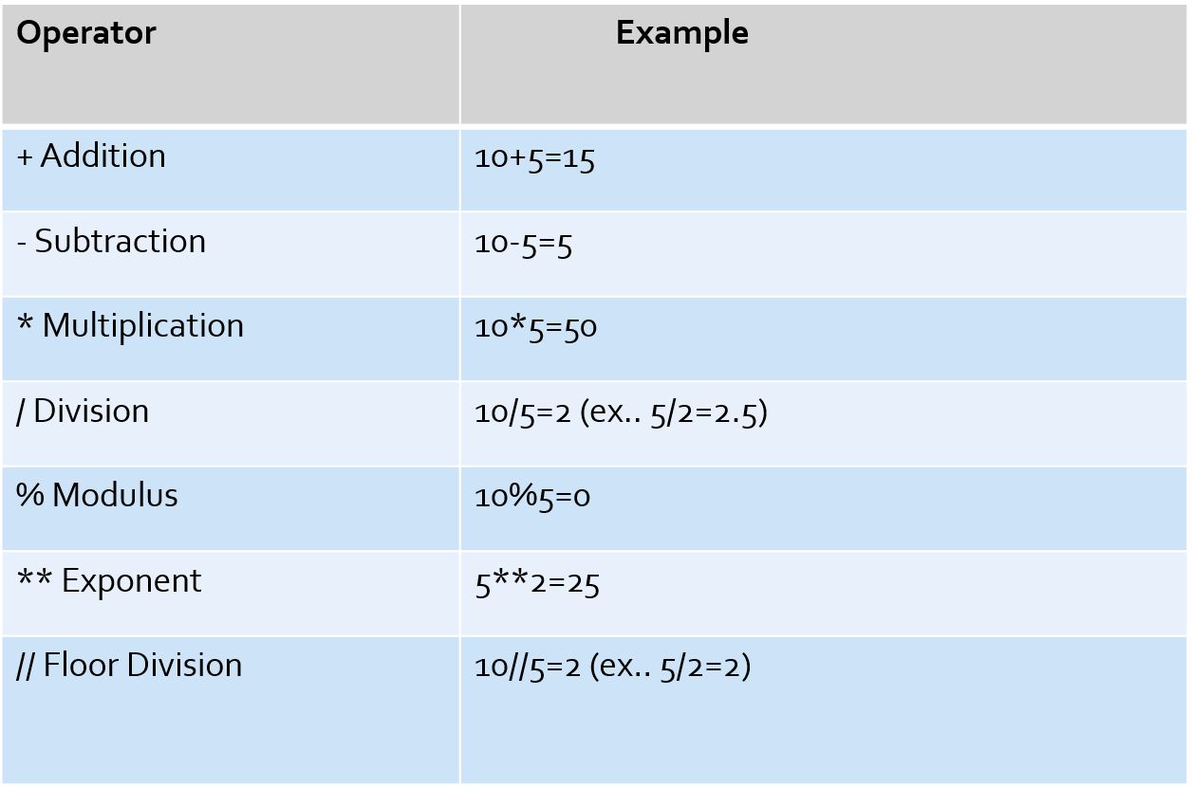
PYTHON ARITHMETIC OPERATORS:

Slide 16
Program for Arithmetic:
x=15
y=4
z=x+y
print(“Addition value = ”,z)
z=x-y
print(“Subtraction value = ”,z)
z=x*y
print(“Multiplication value = ”,z)
z=x/y
print(“Division value = ”,z)
z=x//y
print(“Floor division value = ”,z)
z=x**y
print(“Exponent value = ”,z)
Output:
Addition value = 19
Subtraction value = 11
Multiplication value = 60
Division value = 3.75
Floor division value = 3
Exponent value = 50625

Slide 17
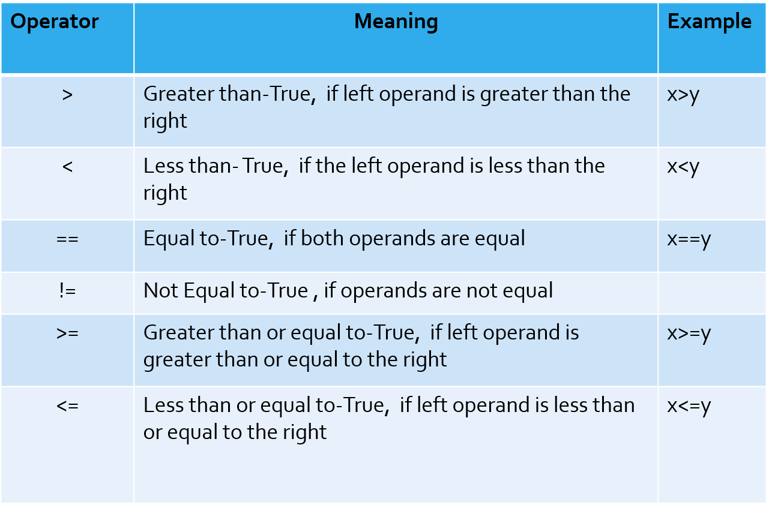
Python Comparison Operators:

Slide 18
Program for comparison operator:
x=10
y=20
z=x>y
print(“x > y is ”, z)
z=x<y
print(“x < y is ”, z)
z=x==y
print(“x == y is ”, z)
z=x!=y
print(“x != y is ”, z)
z=x>=y
print(“x >= y is ”, z)
z=x<=y
print(“x <= y is ”, z)
Output:
x > y is False
x < y is True
x == y is False
x != y is True
x >= y is False
x <= y is True

Slide 19
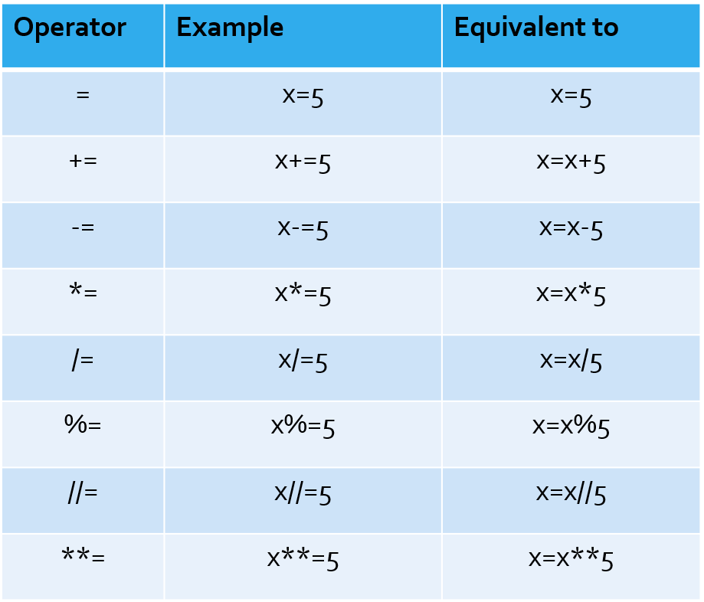
Python Assignment Operators:

Slide 20
Program for Assignment Operators:
A=21
B=10
C=0
C=A+B
print(“ The value of C is”, C)
C += A
print(“ The value of C is”, C)
C *= A
print(“ The value of C is”, C)
C /= A
print(“ The value of C is”, C)
Output:
The value of C is 31
The value of C is 52
The value of C is 1092
The value of C is 52.0

Slide 21
Bitwise operator:
Bitwise operators are used to perform bitwise calculations on integers.
The integers are converted into binary format and then operations are performed bit by bit, hence the name bitwise operators.
Bitwise operators work on integers only and the final output is returned in the decimal format.
Operators:
& Binary AND Operator
| Binary OR Operator
^ Binary XOR Operator
~ Binary Complement Operator
<< Binary Left Shift Operator
>> Binary Right Shift Operator

Slide 22
Program for Bitwise operator:
X=10
Y=4
Z=X&Y
print(“The value of Z is”, Z)
Z=X|Y
print(“The value of Z is”, Z)
Z=~X
print(“The value of Z is”, Z)
Z=X^Y
print(“The value of Z is”, Z)
Z=X>>2
print(“The value of Z is”, Z)
Z=X<<2
print(“The value of Z is”, Z)
Output:
The value of Z is 0
The value of Z is 14
The value of Z is -11
The value of Z is 14
The value of Z is 2
The value of Z is 40

Slide 23
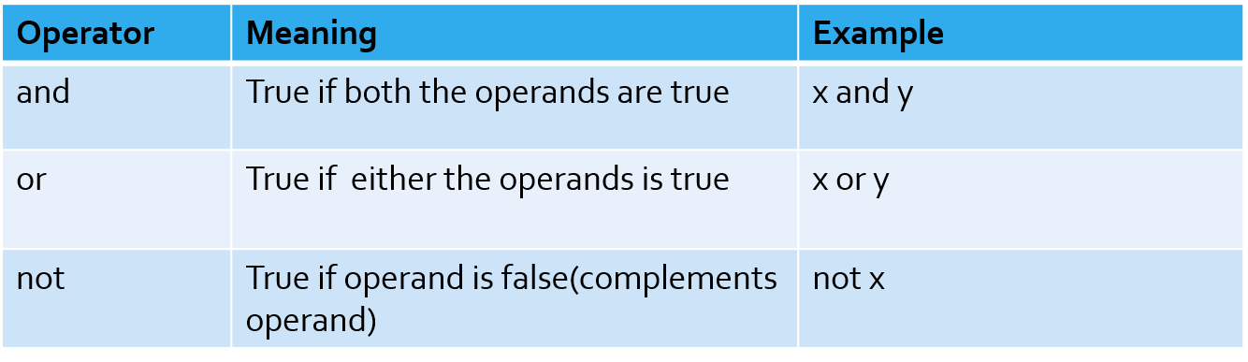
Logical operators:

Slide 24
Program for Logical operator:
x=True
y=False
print(‘x and y is’, x and y)
print(‘x or y is’, x or y)
print(‘not x is’, not x)
Output:
x and y is False
x or y is True
not x is False

Slide 25
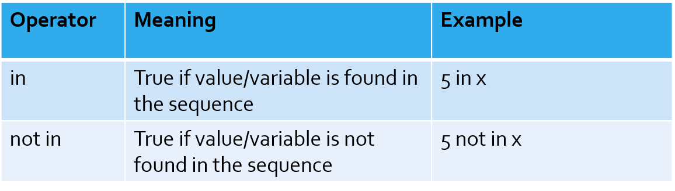
MEMBERSHIP OPERATORS:
Program for Membership operator:
x=‘Hello world’
print(‘H’ in x)
print(‘hello’ not in x)
Output:
True
True

Slide 26
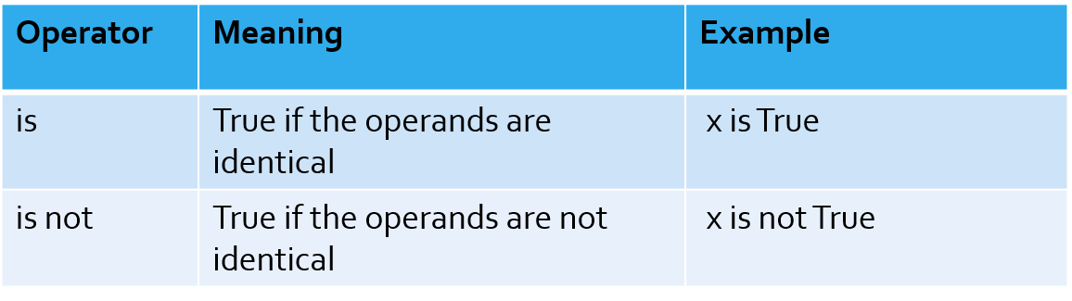
Identity operator:
Program for identity operator:
X1=5
Y1=5
X2=‘Hello’
Y2=‘Hello’
print(X1 is not Y1)
print(X2 is Y2)
Output:
False
True

Slide 27
Exercise:
Write a program in python to calculate area of triangle using semi-perimeter?
Write a program in python to find the square root of a number?
Write a program in python to swap two variables?
Write a python program to find the area of the circle?

